Slide 1
Contemporary Tourism
Planning and Managing the Contemporary Tourism Destination

Slide 2
Lecture Objectives
Understand the key questions facing tourism planning as a field of planning
Recognise the different traditions of tourism planning and their key features
Appreciate the difficulties of developing a sustainable approach to tourism
Recognise how changes in planning may be related to changes in the intellectual and physical environment
Understand the differences between approaches to regional competitiveness and development

Slide 3
Planning and Managing
Plan and manage a complex amalgam of destination products
Nature of the destination demands planning in terms of effective governance and wellbeing
Highly contested issue – depending on positionality

Slide 4
Where does tourism planning occur?
Tourism planning occurs at various scales:
individual firms
Attractions
Destinations
Urban and regional planning
Nations
International, e.g., cross border

Slide 5
Why Plan for Tourism?
Desire to avert negative consequences
Tourism symbiotic with recreation and conservation
Pluralistic
Political
Strategic and integrative
Regional

Slide 6
Development of Planning
Destination planning relatively recent
History of planning
Justification of planning
Rules of the game
Effectiveness in the mixed economy
What planners do

Slide 7
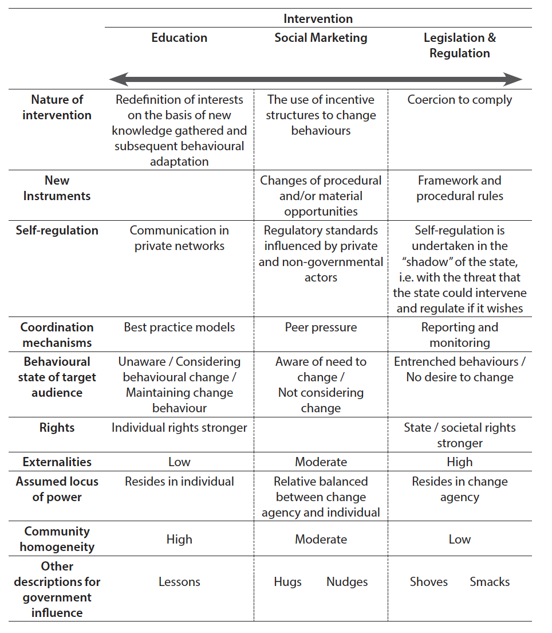
A Continuum of Planning Interventions

Slide 8
Changing Approaches
Due to:
Ideas about planning – also related to ideas of governance
External environment of destination, i.e. what are other destinations doing, the state of the economy
Changes in the destination itself, i.e. environmental conditions, public acceptance of tourism

Slide 9
5 Traditions of Planning
“Boosterism”;
An economic, industry-oriented approach;
A physical/spatial approach;
A community-oriented approach; and
A sustainable tourism approach.
Development of new integrated approaches as well as focus on issues of destination resilience and vulnerability

Slide 10
Boosterism
non-planning
the simplistic attitude that tourism development is inherently good and will be of automatic benefit to the destination
Growth-oriented, with little or no questioning as to the appropriateness of growth

Slide 11
Economic Approach
Constructs the tourism planning problem around economic questions in terms of tourism’s role in destination, regional and national economic growth and development.
Emphasizes the economic impacts of tourism and the most efficient and effective use of tourism to create income and employment benefits for regions, communities or countries.

Slide 12
Physical/Spatial Approach
Derived from urban and regional planning / geography
Economic development is regarded as being dependent on the ‘wise use’ or stewardship of natural resources.
Strong natural area focus, e.g. park planning

Slide 13
Physical/Spatial key themes
Key planning areas from this perspective include:
carrying capacity;
hazard and risk assessment;
stakeholder attitudes,
behaviour and perceptions;
resource and landscape evaluation;
resource appraisal and allocation;
decision-making and evaluation;
the development of appropriate institutional arrangements.

Slide 14
Community Oriented
Suggests that in satisfying local needs it is possible to satisfy the needs of tourists (‘win-win’). Influential, but not adopted because:
Seen as being more time consuming and expensive than other approaches;
Blurred where control lay in decision-making;
Planning outcomes may not meet the more economically oriented agendas of the tourism industry and government

Slide 15
Sustainable Tourism
Ideas of sustainable development have been hugely influential in destination planning and planning legislation.
The transformation of the principles of sustainable development into successful planning interventions has been extremely difficult

Slide 16
Sustainable Tourism Planning Strategies
Cooperative and integrated control systems
Development of industry coordination mechanisms
Raising consumer awareness
Raising producer awareness
Strategic planning
Increased regulation

Slide 17
Responsibility for Destination Planning
No single agreed approach
Destination organizations have different traditions and responsibilities
Rare to have a single agency with destination responsibility, but more likely in small states or in a location with a very high economic dependence on tourism

Slide 18
Sustainable Destinations and Regions
Tourism as the most appropriate use for destinations
Whole of destination approach
Low road (duplication of the attributes of other destinations) or high road (focus on knowledge capacity and innovation) policies
Emergence of smart tourism destinations

Slide 19
Summary of Key Points
Contemporary tourism planning is oriented towards sustainable tourism development.
The ideal planning style is integrative, seeking to combine, social, environmental and economic planning goals and satisfy stakeholder aspirations.
Integrative planning is extremely difficult to achieve
Tourism’s need to contribute more broadly to sustainability and regional development

